Slide 1
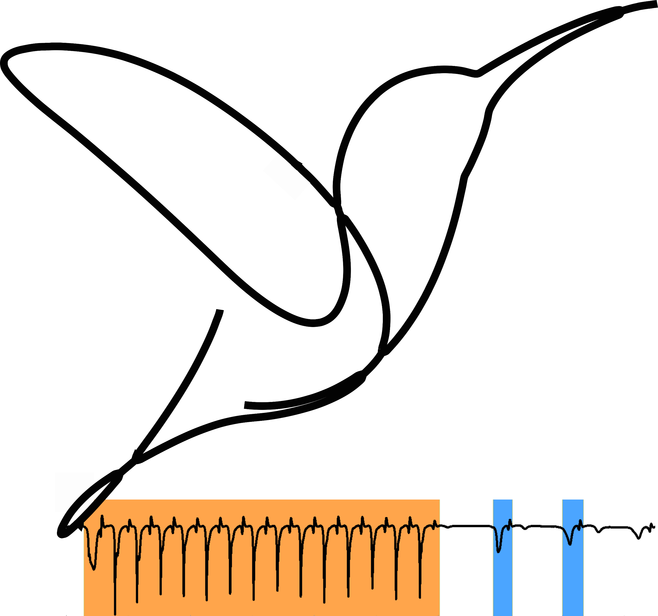
Ethograph
A GUI for visualizing and segmenting
multimodal behavioural timeseries data

Slide 2
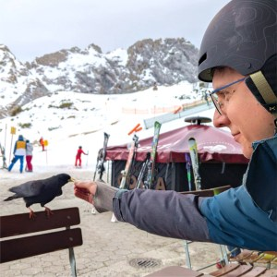

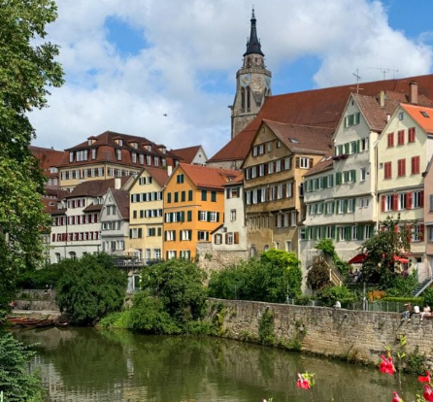
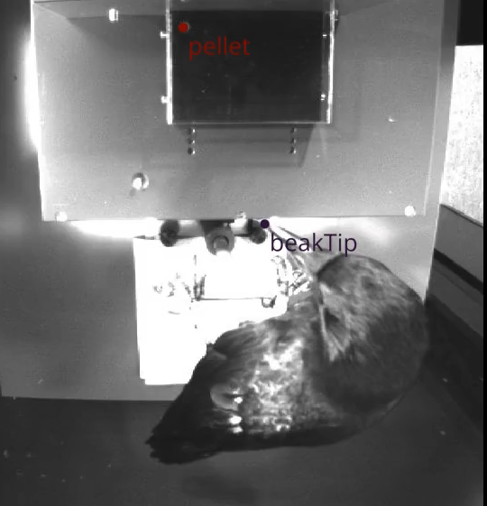
Background
Moll lab
Master/PhD in Tübingen, Germany
Tool-using carrion crows

Slide 3

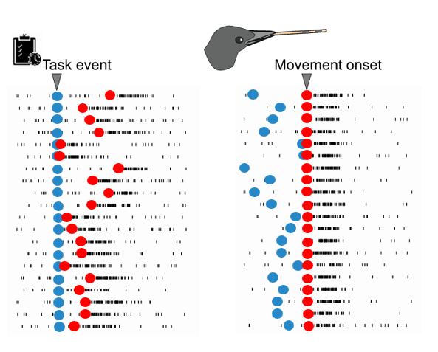


Where it started
“I like the idea that emerged here: detect changepoints and use them as starting points for a template-matching strategy.”
“it wouldn't be the everything-all-at-once that you get from most packages that you see in recent papers”

Slide 4
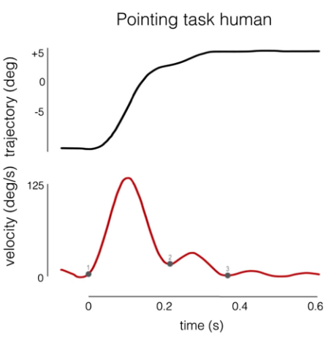
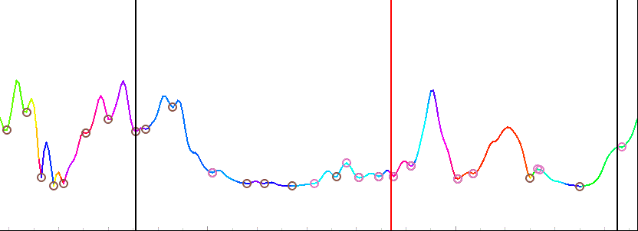
Changepoints
Correct human labelling
speed
Meyer et al., 1988
Torricelli et al., 2022

Slide 5
Live demo
Basic navigation/playback
Labelling
Combos
Trial navigation
Label/sequence navigation

Slide 6
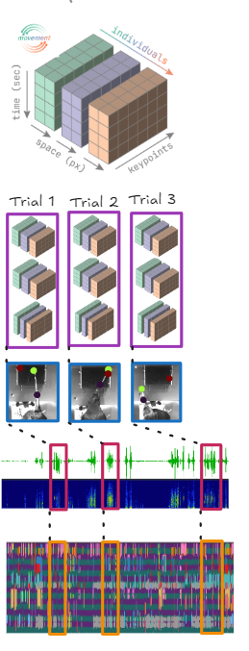
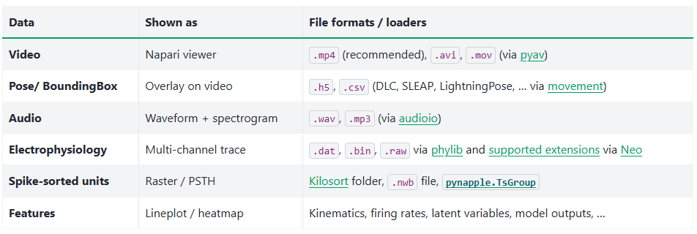

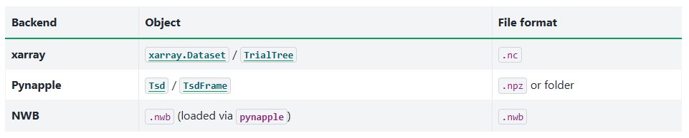
Input/Output

Slide 7
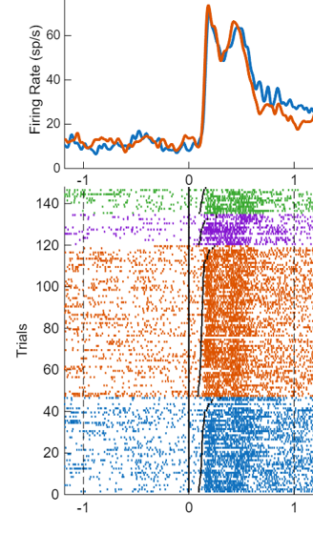
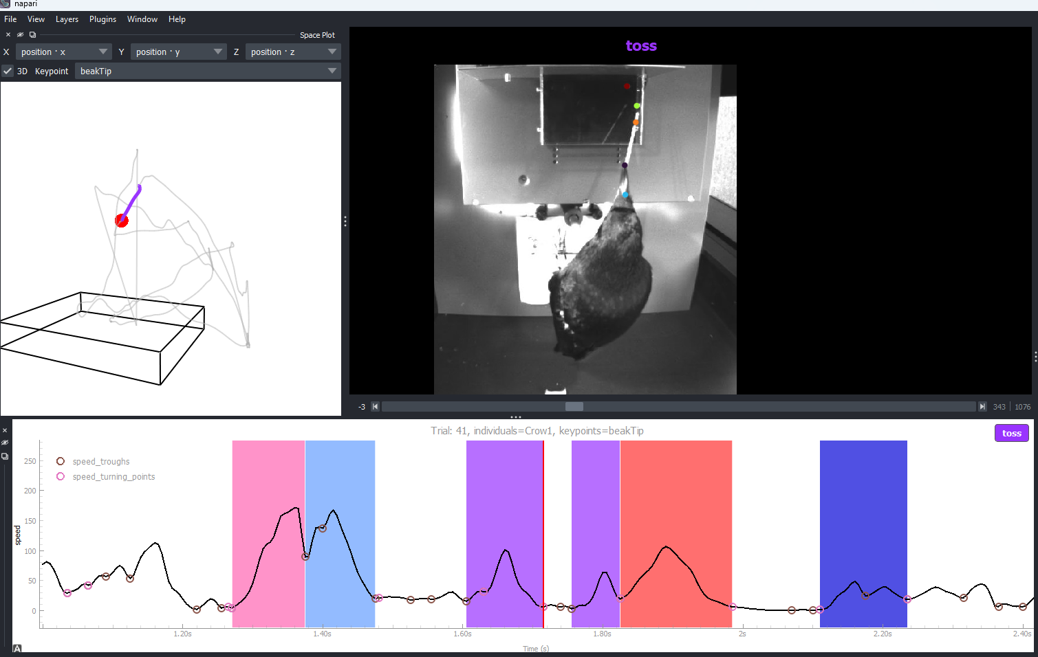
Beautiful neurons!

Slide 8
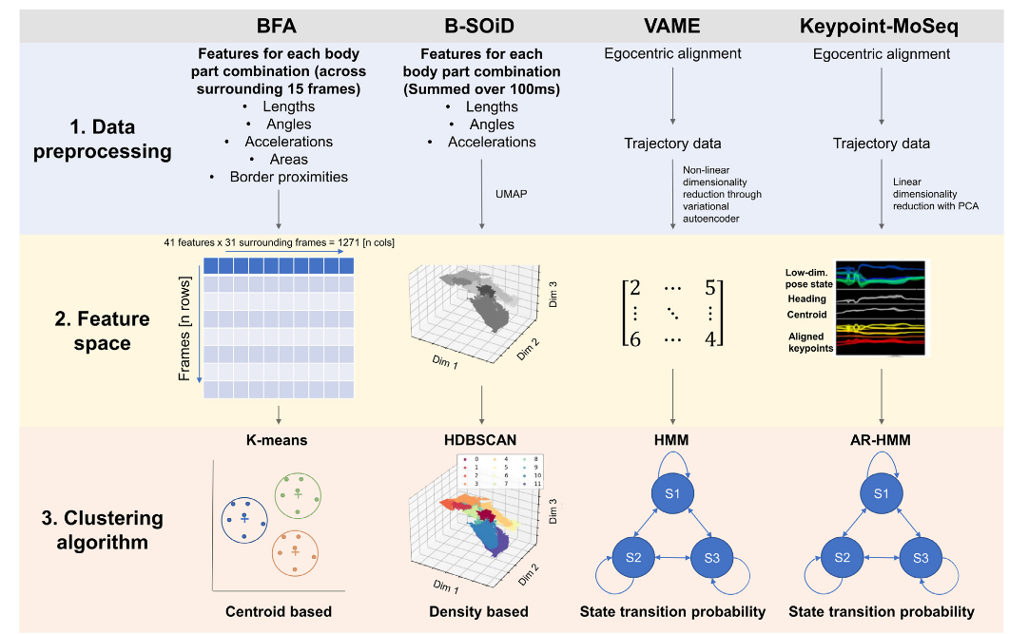
Behavioural segmentation pipelines
“it wouldn't be the everything-all-at-once that you get from most packages that you see in recent papers”
Mlost et al., 2025

Slide 9
Another pipeline...
For my master thesis, I developed

Slide 10
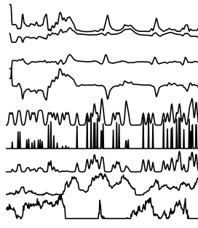
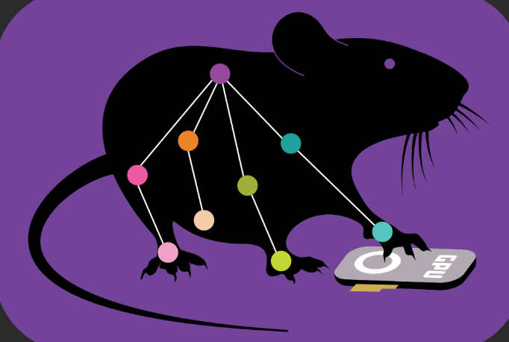

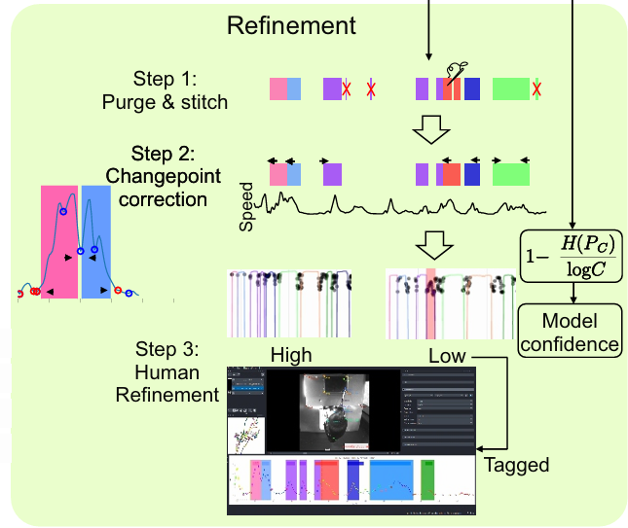
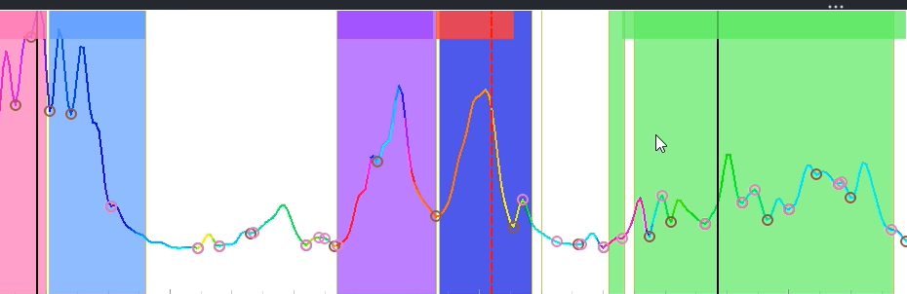

Feature Engineering
Video frames
in one trial
Kinematic features
positions, velocities, speed, pairwise distances
Transformer model
(Yi et al., 2019)
Changepoint
features
(512, 562, T)
Video features
(Xie et al., 2018)
Time
(61, T)
Refinement
Ground truth
Model predictions
Syllable segments

Slide 11
Can we make this more modular?

Slide 12

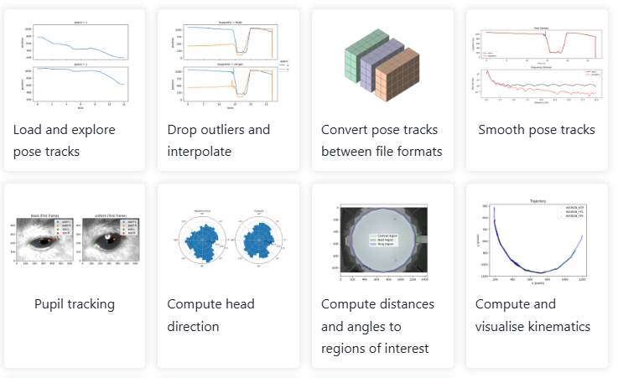
Problem:
These change
every year
Video frames
in one trial
Feature
Engineering
Segmentation
models
(512, 562, T)
Refinement
- Video features?
- Changepoint features?
Syllable segments

Slide 13

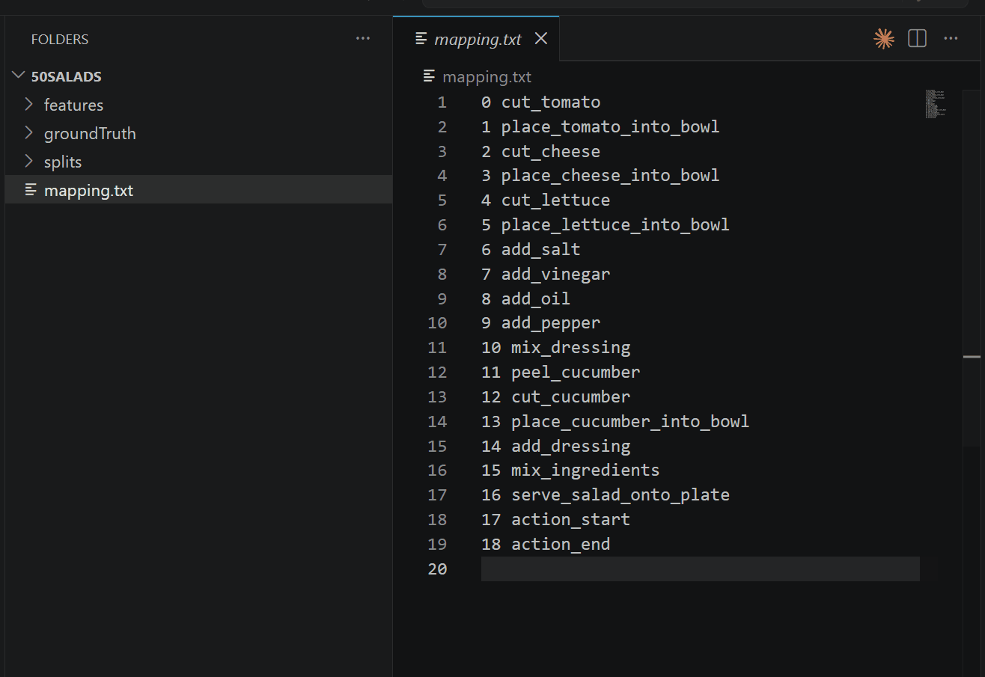
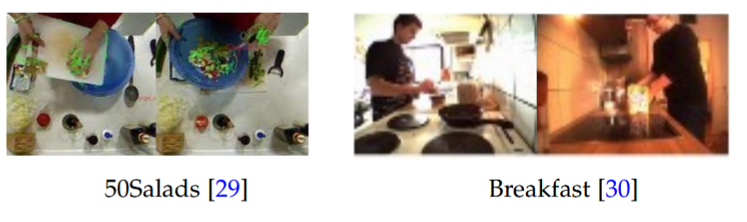
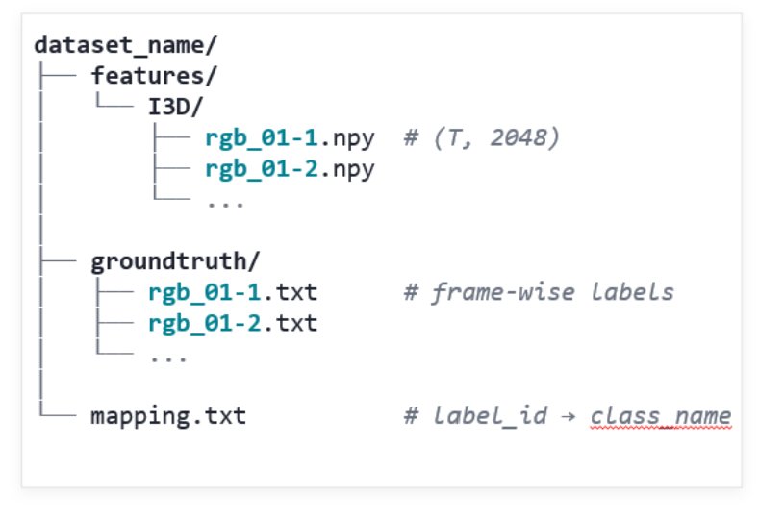
Case study:
https://zenodo.org/records/3625992#.Xiv9jGhKhPY)

Slide 14
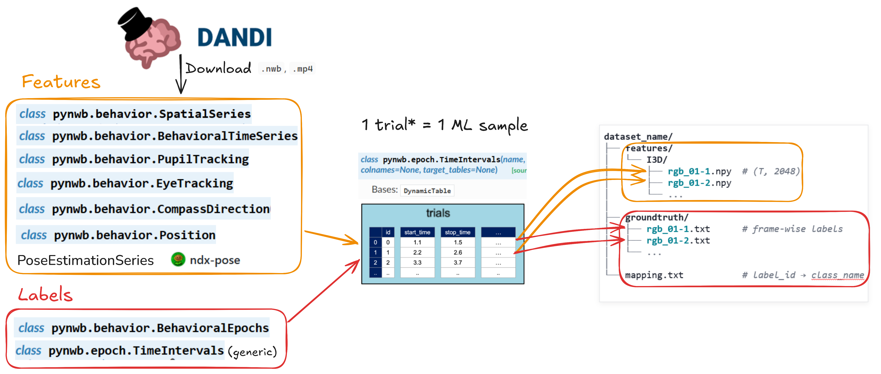
Making behaviour segmentation more modular
Notes:
* Doesnt have to be trial, can just be parcelated

Slide 15
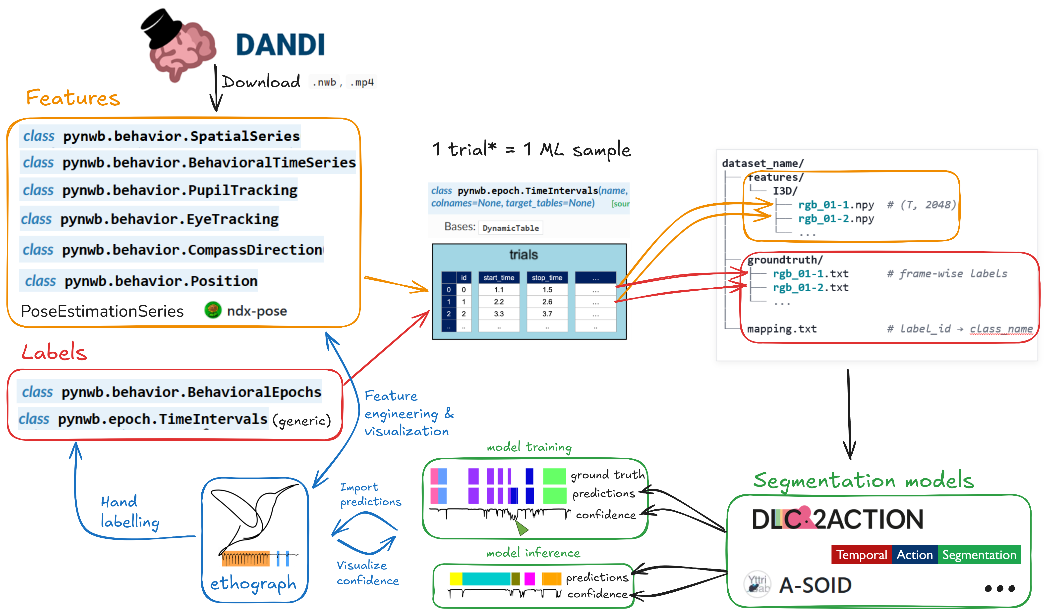

Slide 16
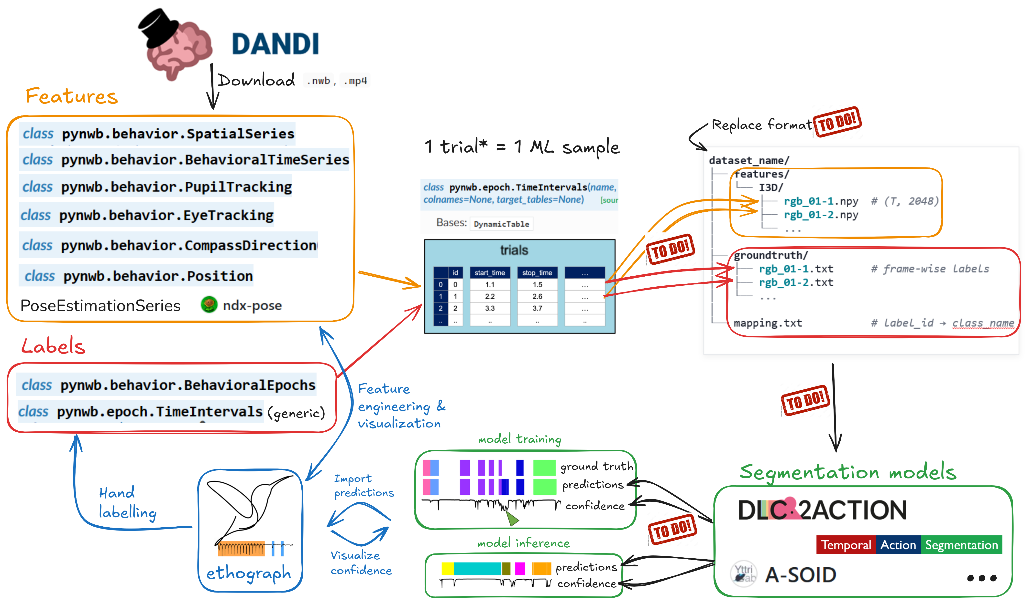

Slide 17
Helpful links
Ethograph Documentation
https://akseli-ilmanen.github.io/ethograph
NWB
pynwb.behavior module — PyNWB 3.0.0 documentation
Temporal Alignment: https://github.com/NeurodataWithoutBorders/nwb-schema/issues/677
Temporal Action Segmentation
Resources: https://github.com/nus-cvml/awesome-temporal-action-segmentation
Case study data format: https://zenodo.org/records/3625992#.Xiv9jGhKhPY)
Review: https://ieeexplore.ieee.org/document/10294187

Slide 18
Q&A

Slide 19
Extras

Slide 20
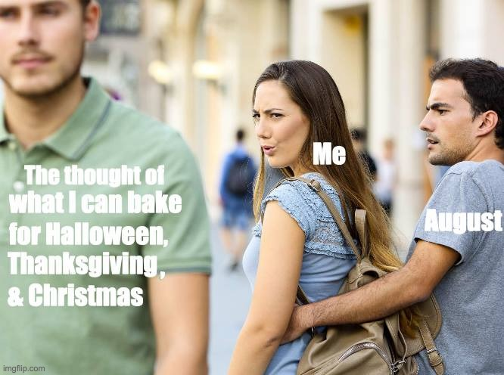


Temporal Alignment

Slide 21
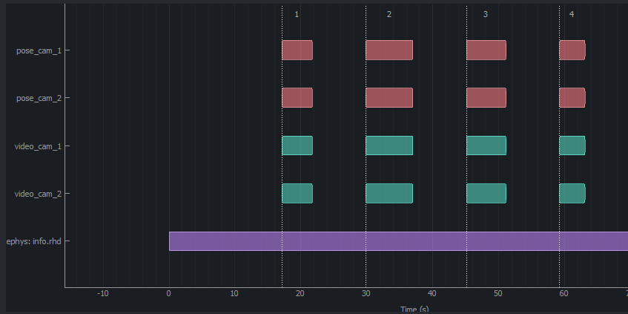
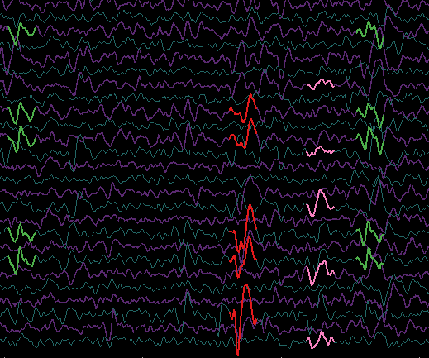

Temporal Alignment

Slide 22
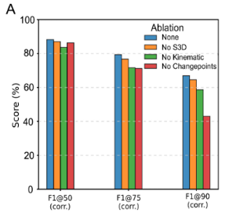
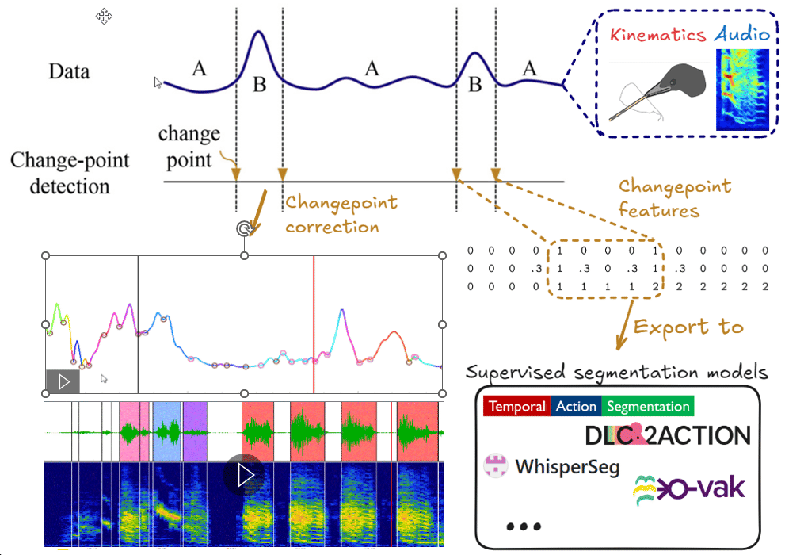
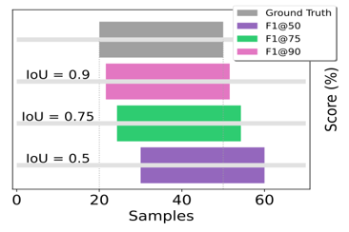
Changepoint features
Notes:
Top left graph shows that when removing changepoint features, a transformer model does a lot worse at fine-grained segmentation.

Slide 23
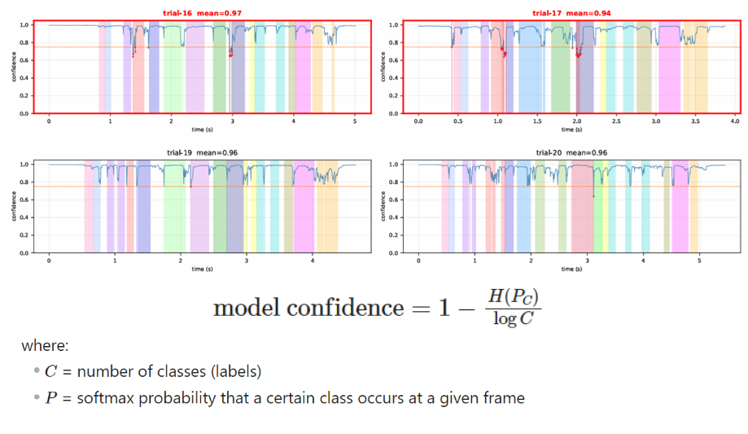
Model confidence

